Slide 1

Database Management system
Lecture 7 (Part 1)
The Enhanced Entity-Relationship
(EER) Model
Dr. Rihab Mohamed Naceur ABDELKRIM
E-mail: rihab@su.edu.sa
2017 - 2018

Slide 2
Recall of lecture 6
1- Unary Relational Operations: SELECT and PROJECT
2- Relational Algebra Operations from Set Theory
3- Binary Relational Operations: JOIN and DIVISION
4- Additional Relational Operation
5- The Tuple Relational Calculus
6- The Domain Relational Calculus

Slide 3
Outline
1- Subclasses, Superclasses, and Inheritance
2- Specialization and Generalization
3- Constraints and Characteristics of Specialization and Generalization Hierarchies
4- Modeling of UNION Types Using Categories
5- A Sample UNIVERSITY EER Schema, Design Choices, and Formal Definitions
6- Example of Other Notation: Representing Specialization and Generalization in UML Class Diagrams
7- Data Abstraction, Knowledge Representation, and Ontology Concepts

Slide 4
Recall about Entity-Relationship (ER) model
Entity-Relationship (ER) model, which is a popular
high-level conceptual data model.
This model and its variations are frequently used for the conceptual design of database applications.
Many database design tools employ its concepts.

Slide 5
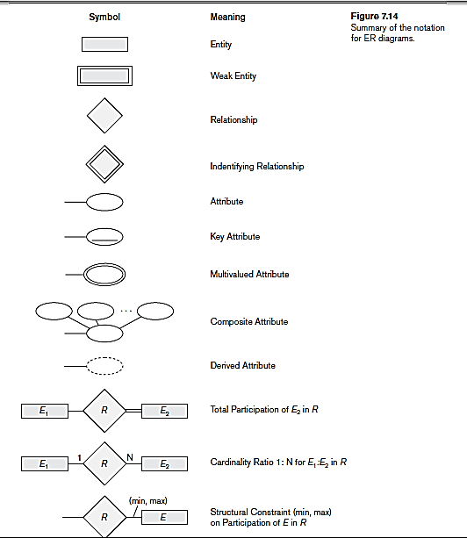

Slide 6
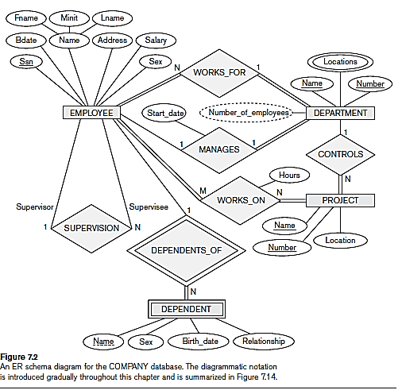
Example of ER model

Slide 7
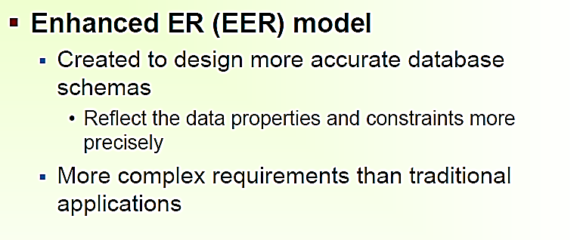
Introduction to EER model

Slide 8
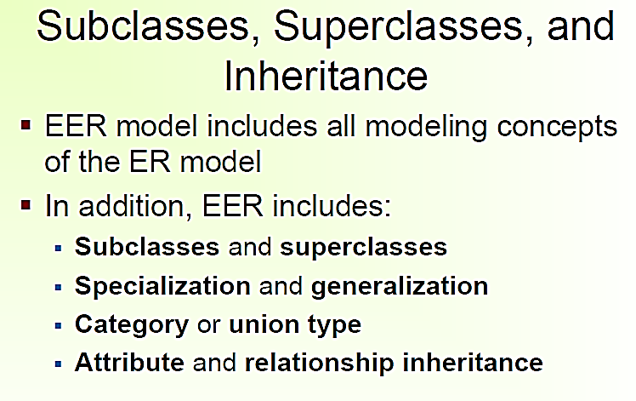

Slide 9
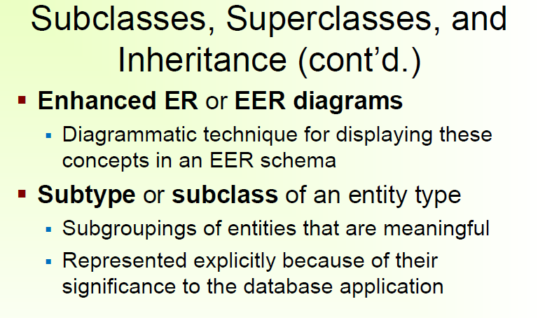

Slide 10
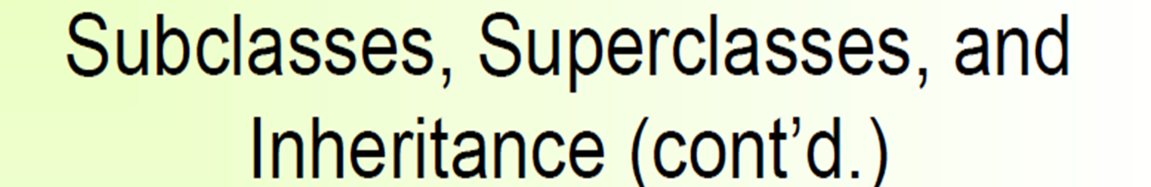
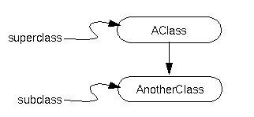
The derived class (the class that is derived from another class) is called a subclass.
The class from which it's derived is called the superclass.
The following figure illustrates these two types of classes:

Slide 11
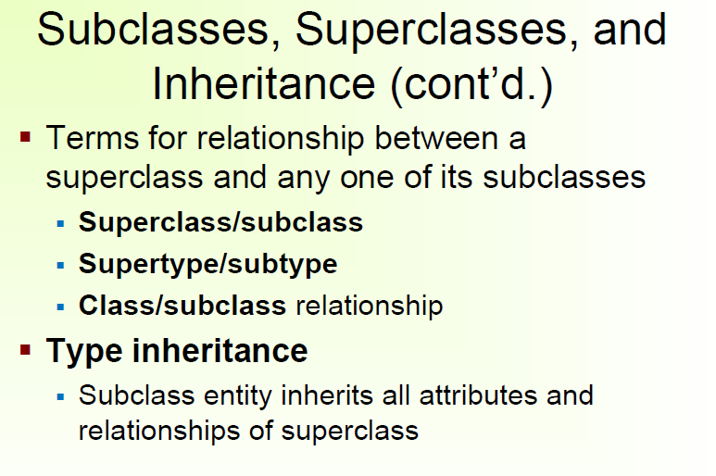

Slide 12
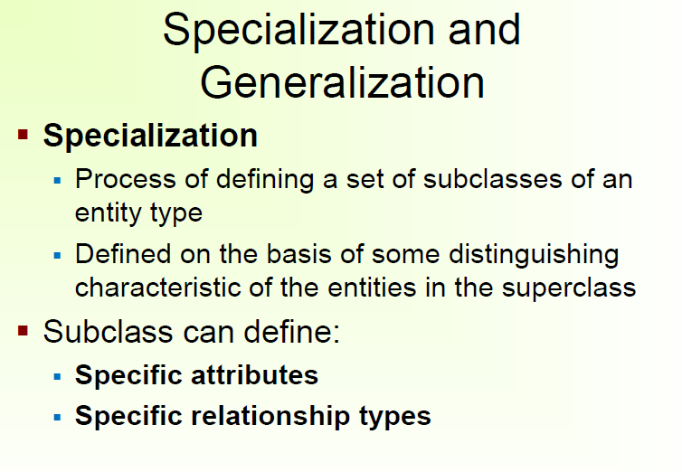

Slide 13
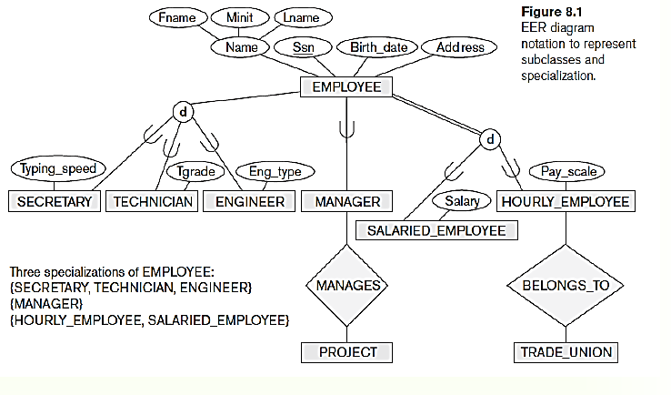
Example
superclass
Entity type
Set of subclasses
For example, the set of subclasses {SECRETARY, ENGINEER, TECHNICIAN} is a specialization of the superclass EMPLOYEE that distinguishes among employee entities based on the job type of each employee entity.

Slide 14
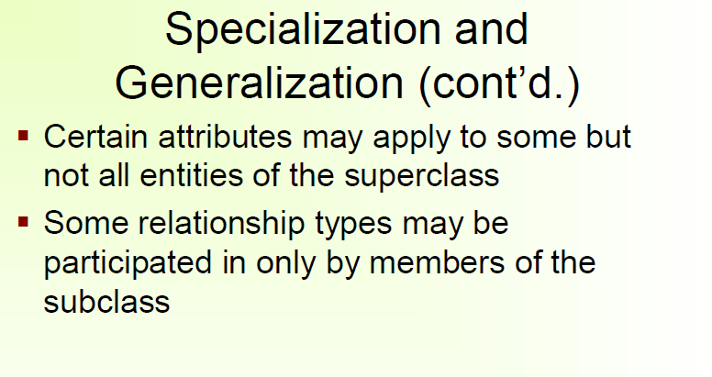

Slide 15
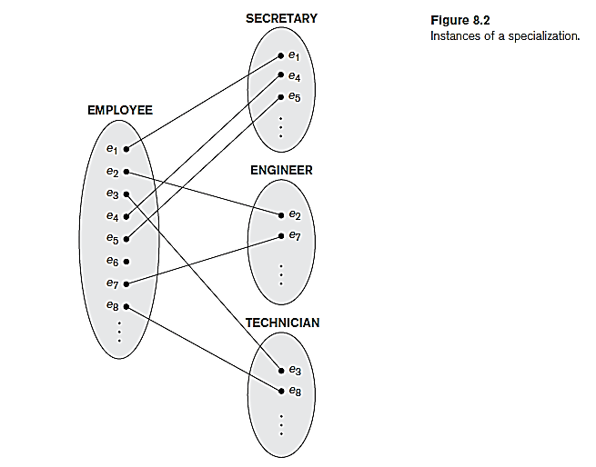
Example

Slide 16
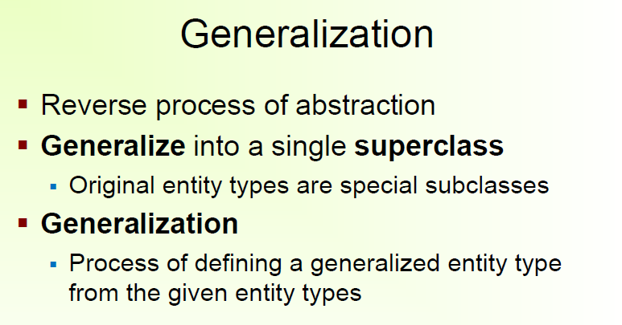
We can think of a reverse process of abstraction in which we suppress the differences among several entity types, identify their common features.
Generalize them into a single superclass of which the original entity types are special subclasses.

Slide 17
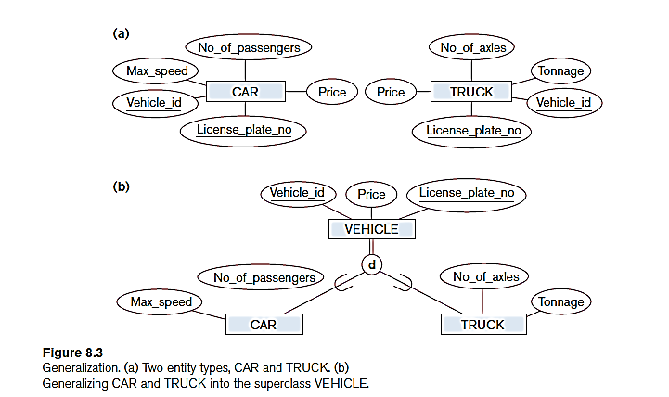
Example

Slide 18
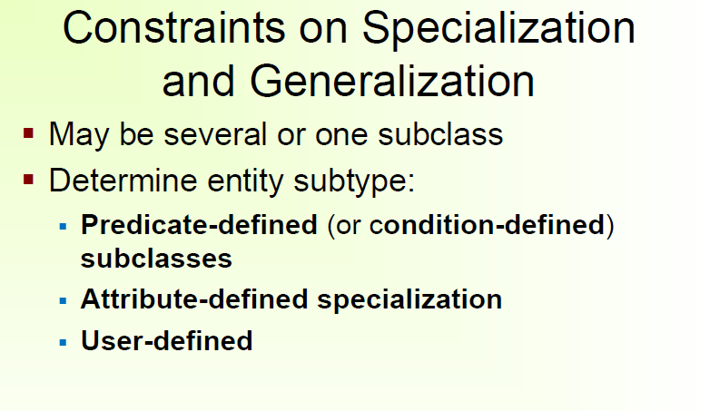
When we do not have a condition for determining membership in a subclass, the subclass is called user-defined.

Slide 19
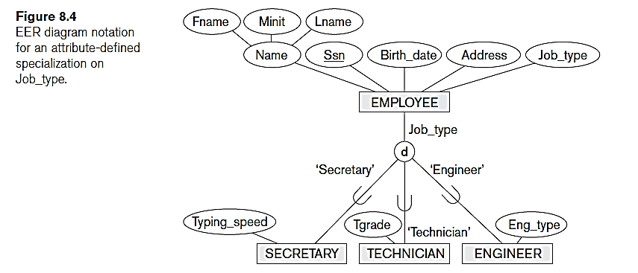
Example
Defining predicate of the subclass
Defining attribute of the specialization

Slide 20
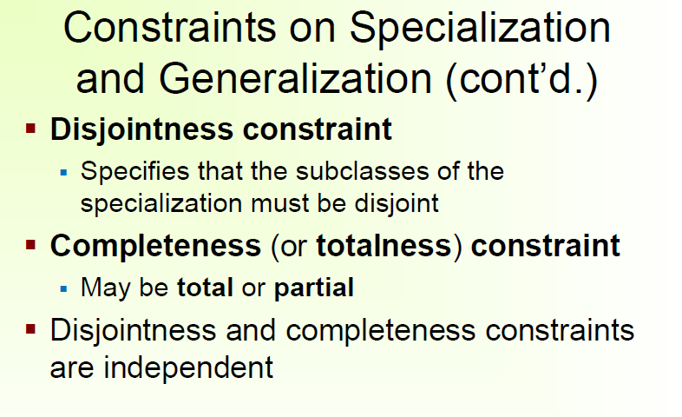

Slide 21
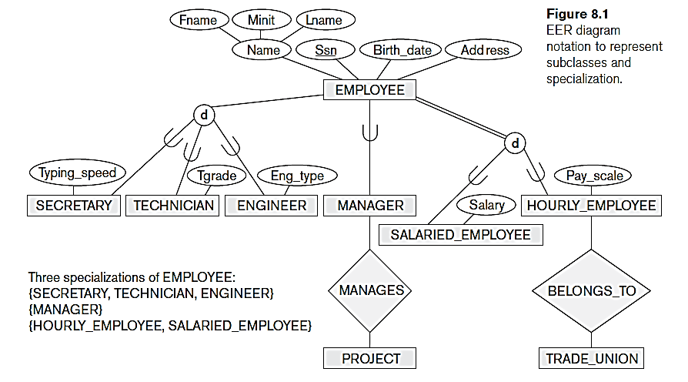
Example
Partial specialization
Total specialization

Slide 22
Interpretation of Example
A total specialization constraint specifies that every entity in the superclass must be a member of at least one subclass in the
specialization.
For example, if every EMPLOYEE must be either an HOURLY_EMPLOYEE or a SALARIED_EMPLOYEE, then the specialization {HOURLY_EMPLOYEE, SALARIED_EMPLOYEE} in Figure 8.1 is a total specialization of EMPLOYEE.
This is shown in EER diagrams by using a double line to connect the
superclass to the circle.
A single line is used to display a partial specialization, which allows an entity not to belong to any of the subclasses.
For example, if some EMPLOYEE entities do not belong to any of the subclasses {SECRETARY, ENGINEER, TECHNICIAN} in Figure 8.1, then that specialization is partial.

Slide 23
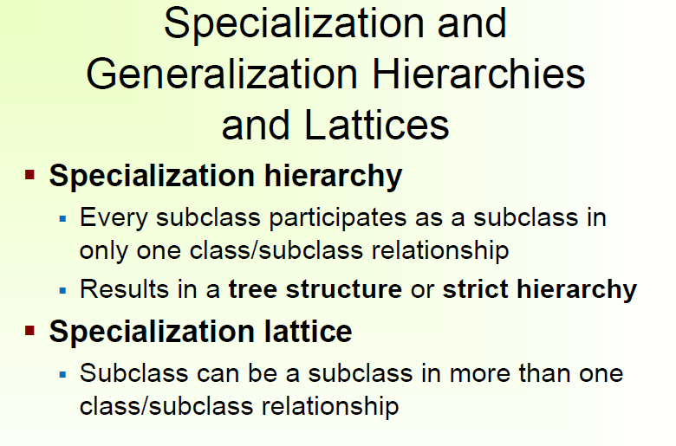

Slide 24
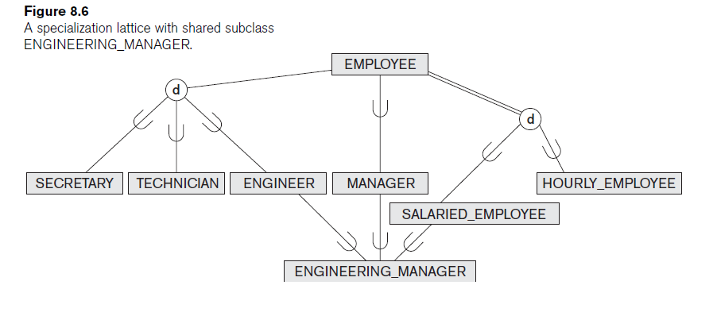
Example

Slide 25
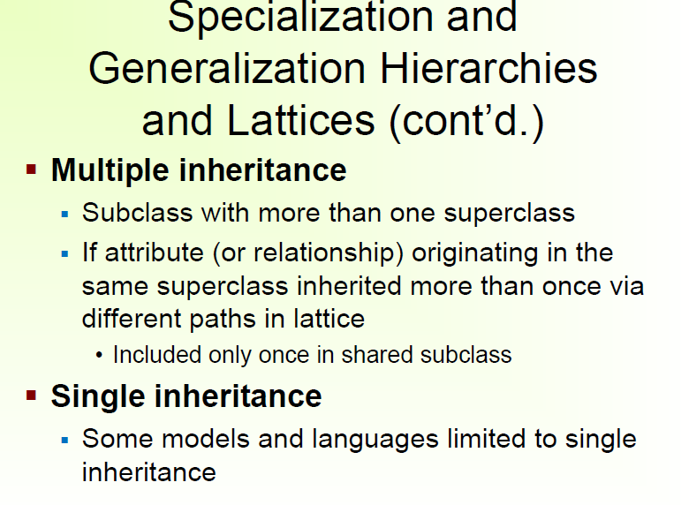

Slide 26
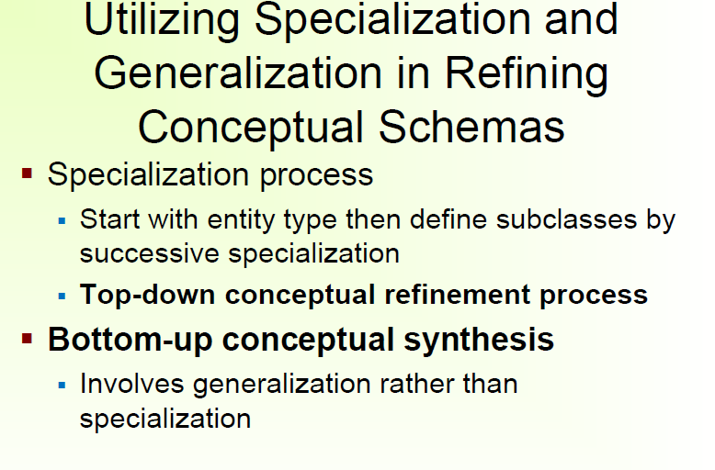
This successive specialization corresponds to a top-down conceptual refinement process during conceptual schema design.

Slide 27
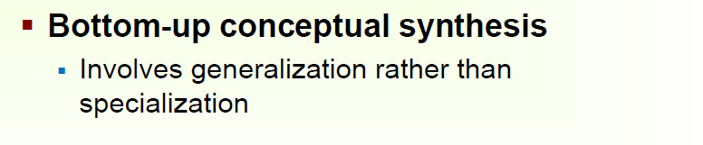

Slide 28
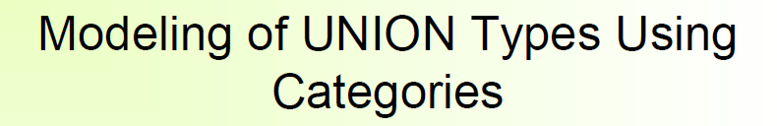
Sometimes it is necessary to represent a single superclass/subclass relationship with more than one superclass.
where the superclasses represent different entity types.
In this case, the subclass will represent a collection of objects that is a subset of the UNION of distinct entity types;
we call such a subclass a union type or a category.

Slide 29
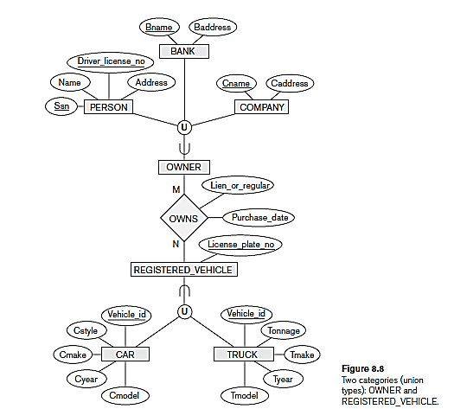
Example
OWNER : A category (union type) that is a subclass of the UNION of the three entity sets of COMPANY, BANK, and PERSON.
UNION

Slide 30
A category can be total or partial.
A total category holds the union of all entities in its superclasses,
whereas a partial category can hold a subset of the union.
A total category is represented diagrammatically by a double line connecting the category and the circle, whereas a partial category is indicated by a single line.

Slide 31
Example
partial category
total category

